Slide 1
Aspect-Oriented Programming
Conf. dr. ing. Guillaume DUCOFFE
guillaume.ducoffe@fmi.unibuc.ro

Slide 2
Introducing myself
2013-2014: Master of engineering (Univ. Nice, France) and of informatics (ENS Cachan, France)
2014-2016: PhD about some Applications of Graph Theory in Networks
since 2017: Scientific Researcher at I.C.I Bucuresti
since 2018: Lecturer at UB Informatics Department
Since 2021: Assistant professor

Slide 3
Additional Information
My website: https://sites.google.com/view/guillaume-ducoffes-homepage/home
(course material available for download on request)
Office in Room 318
Some Research Questions that haunt me more than others…
How can we scale Internet Routing protocols?
Can we predict the evolution of Twitter?
Can Online Users safely collaborate to detect Data misuse?
How should we design Onion-router topologies?
a lot of nice mathematics (Graph Theory, Algorithmic) and coding.

Slide 4
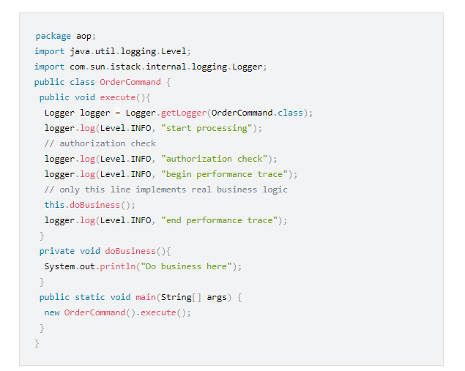
What is wrong with this code?

Slide 5
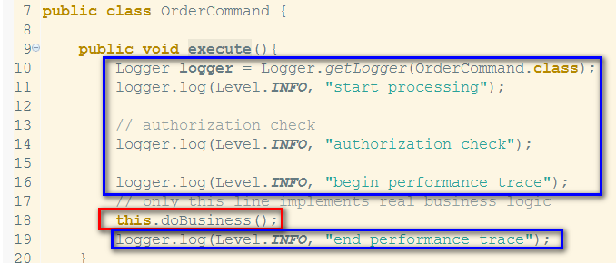
What is wrong with this code?
The Business Logic is flooded by non-functional code!

Slide 6
A short history of programming paradigms
Model | Year | Preoccupation | Brick basis | Language
Structured Programming | 1950’s | Control flow | Instruction | ALGOL, Pascal, Ada…
Procedural Programming | 1960’s | Code portions | Procedure calls | BASIC, C
Object Oriented Programming | 1970’s | Data as Objects | Class | Java, C++…
Aspect Oriented Programming | 2001 | Cross-cutting concerns | Aspect | Compatible with most languages

Slide 7
Cross-cutting concerns
Logging,
Security manager,
Communication with DBs, Network connection, etc…
~ Non-functional requirements In complement to Business Logic

Slide 8
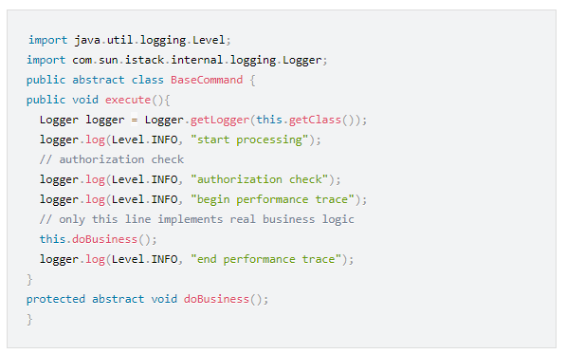
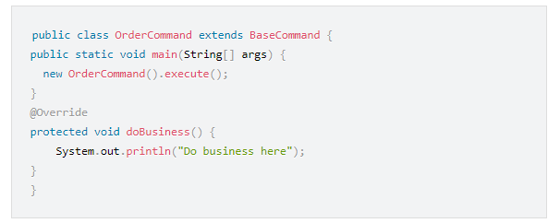
First Try: Template Method Pattern
Delegate some behaviours (e.g., abstract class/subclasses)

Slide 9
Template Method Pattern: Drawbacks
Change of behaviour for ``execute()’’ (e.g., no authorization) would require an override/ a modification of the abstract class.
Redundancy
Maintenance
Growing number of SLOCs…

Slide 10
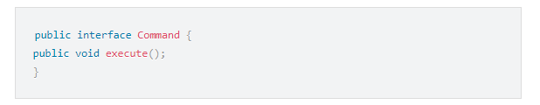
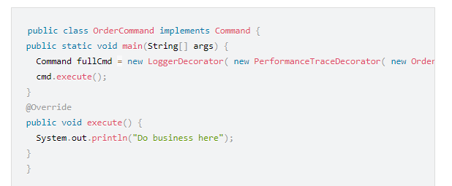
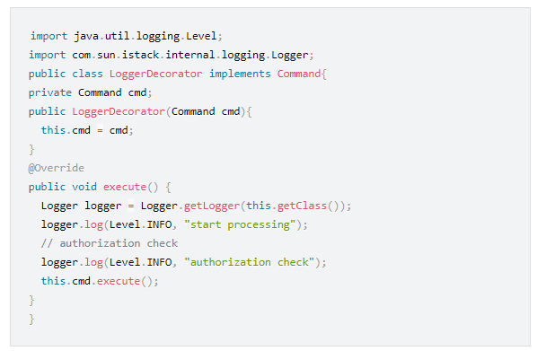
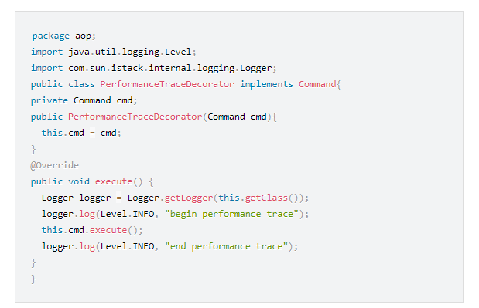
Second Try: Decorator Pattern
Adding a new functionality through an interface

Slide 11
Decorator Pattern: Drawbacks
The decorator and the business class must implement the same interface.
Redundancy
Maintenance
Growing number of SLOCs…

Slide 12
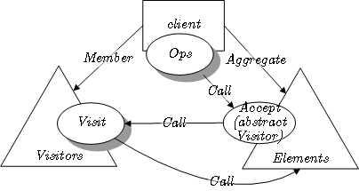
Yet another try: Visitor Pattern
Allowing a class to modify objects from another class
(external operations)

Slide 13
Visitor Pattern: Drawbacks
Against the ``Object-Oriented’’ paradigm
Growing number of SLOCs…
Interdependencies

Slide 14
Current Issues
Two strikes against modularity:
Scattered code. E.g., every class accessing to a DB must implement similar procedures (redundancy, non functional)
Cross-coding. Business logic procedures are flooded by non-functional calls.

Slide 15
Some Negative Consequences
Tracking. Mapping goals/implementation becomes hard to understand…
Decrease in Productivity. Programmers loose the focus on Business Logic.
Code is less reusable. Other modules could share ``almost same’’ non-functional requirements, but under some changes…
Code quality. Border effects, bugs (over constrained)
Maintenance. Cascading effect.

Slide 16
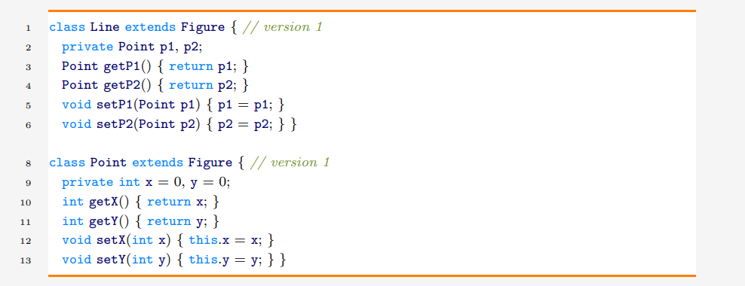
Another Example: Points and Line
Objective: Move Tracker

Slide 17
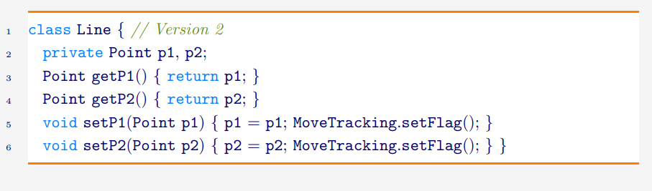
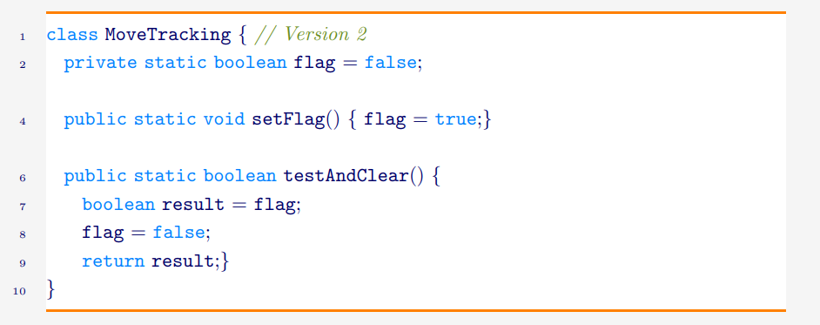
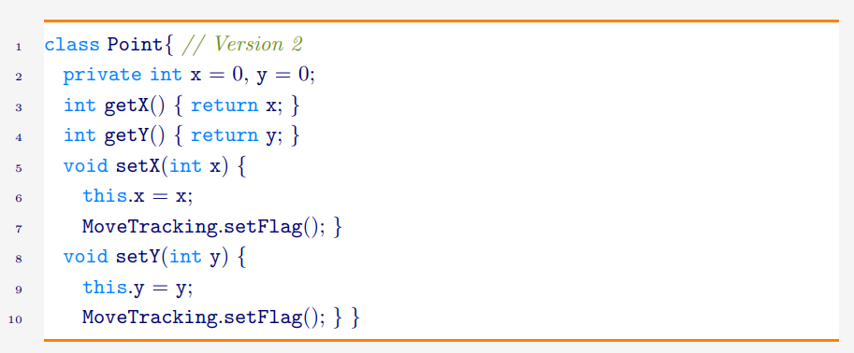
First Try
Question: Which Design Pattern?

Slide 18
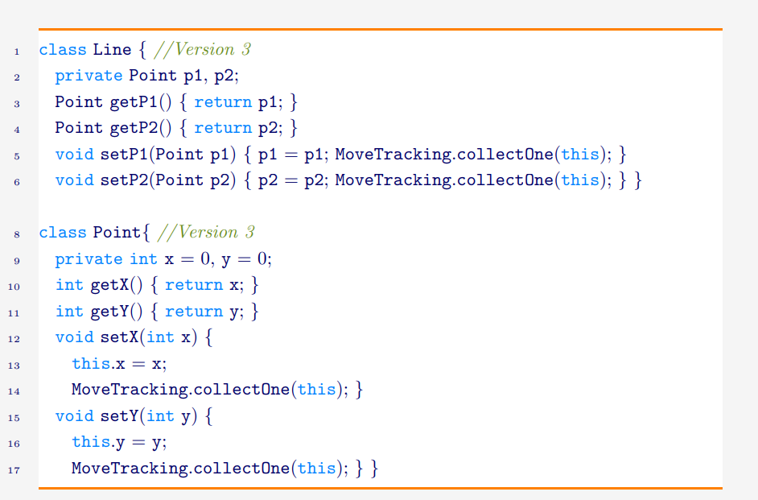
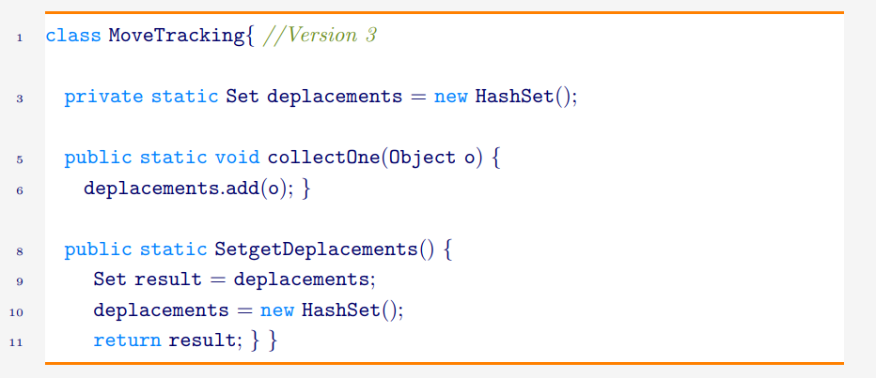
Second Try: with history
Previous approach does not support evolution….

Slide 19
More examples
We use some existing application for our business, but there is no Logging module included.
Validation of the parameters for all the methods from the Service layer.
Repackaging of some exceptions before them being sent on the Client side (conversion of Java exception to a Service-defined exception).

Slide 20
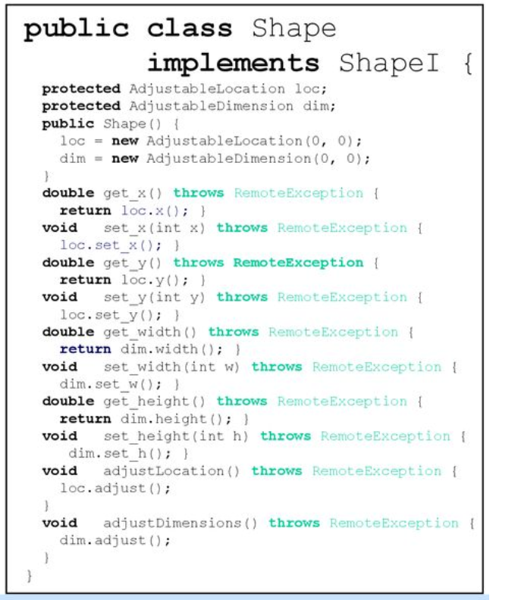
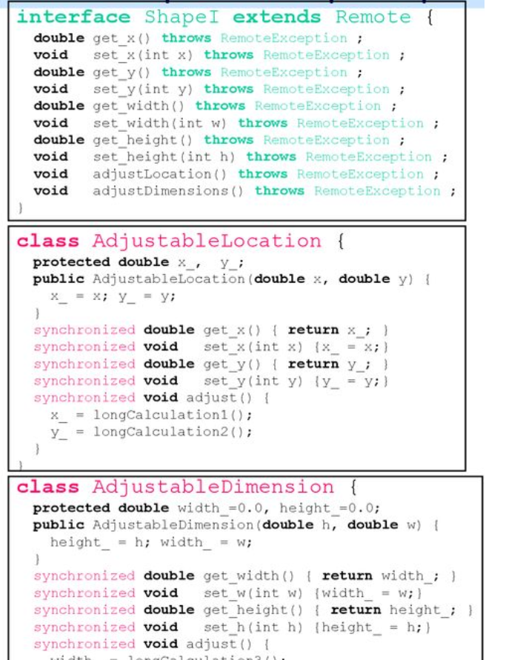
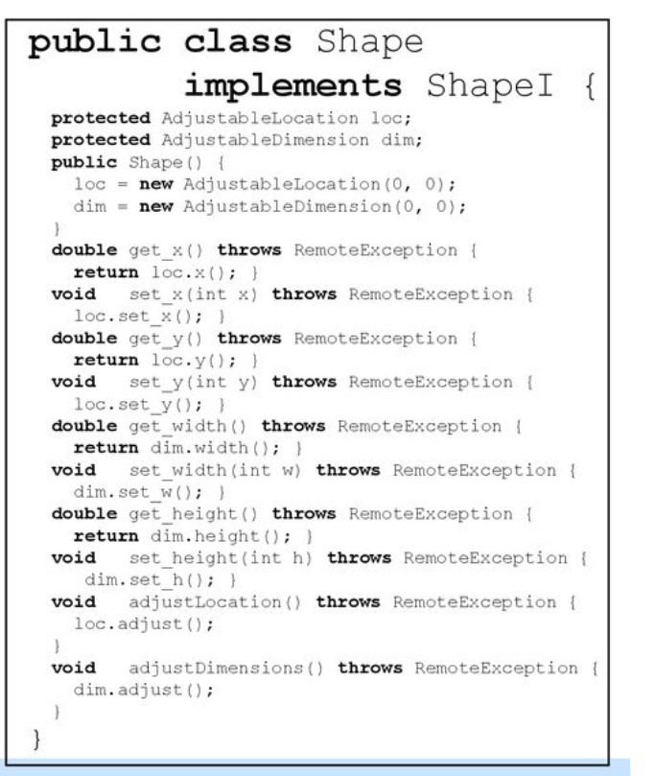
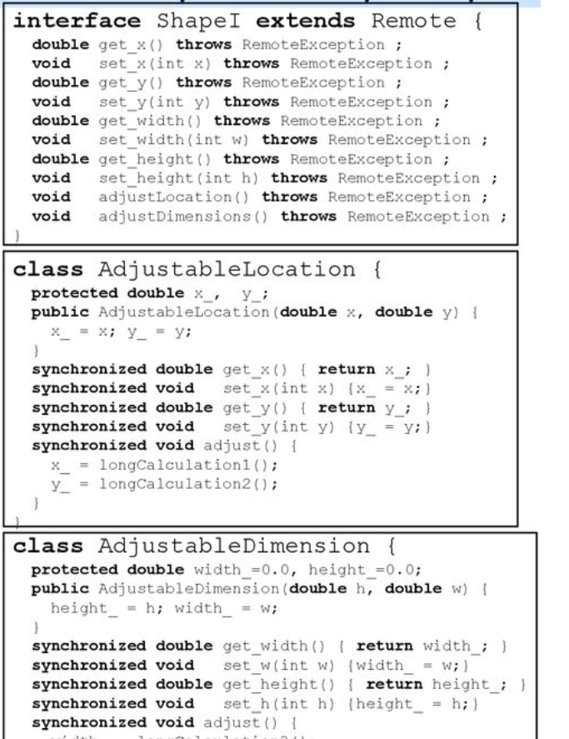
Identifying cross-cutting concerns

Slide 21
Separation of Concerns
Non-functional requirements are specified apart from the Business Logic. Behaviour/Representation/Execution are modified during/after the compilation or at runtime or at loading (meta-programming)
Example: the key-word synchronized in Java.
New functionalities can be incorporated without any modification of the Business classes.
Key-words: Aspect, Advice, Pointcut, Joint-point.

Slide 22
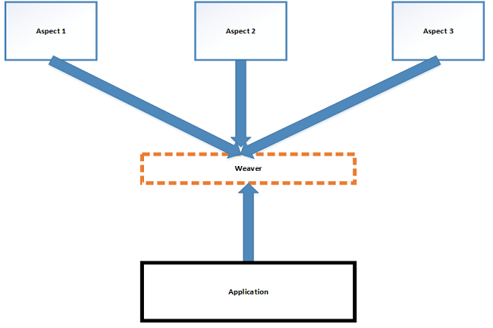
Schematic View
Aspect: Non-functional
Advice: Code modification
Joint-point: Insertion
Pointcut: points identification

Slide 23
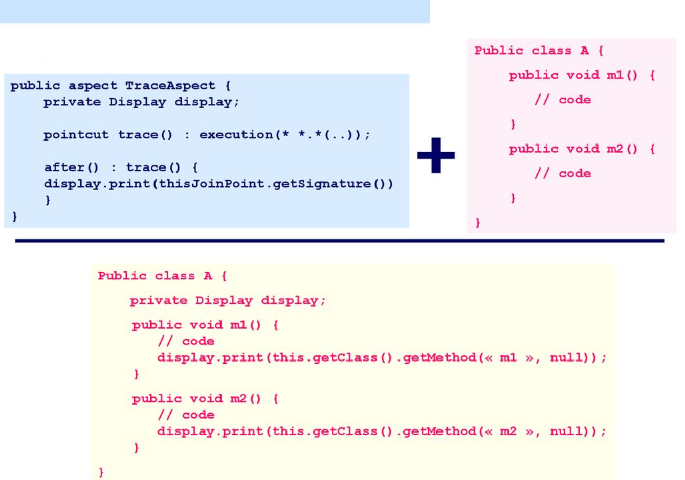
Example of generated code

Slide 24
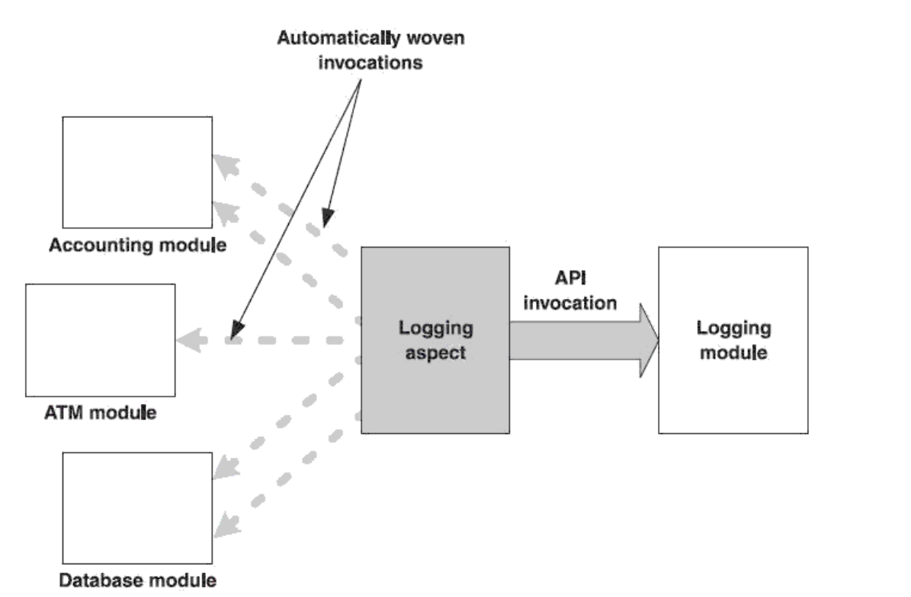
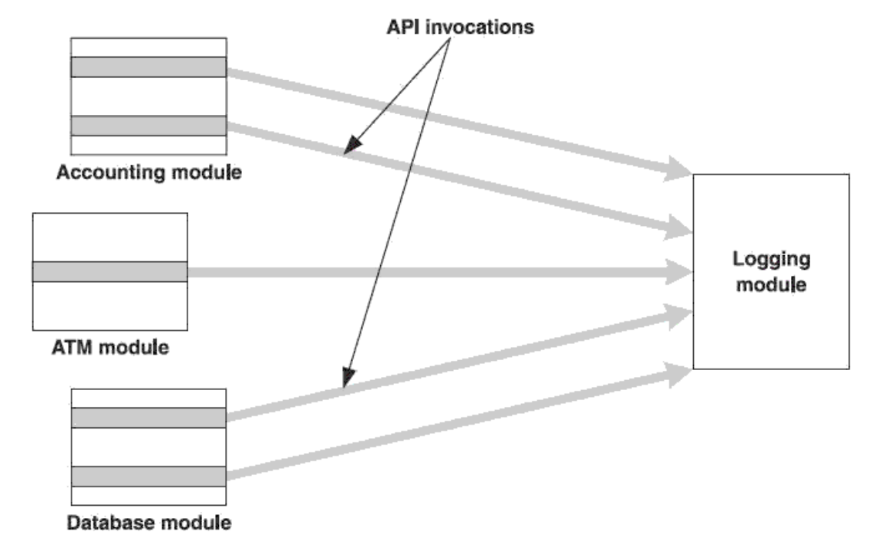
Comparison between OOP and AOP
OOP
AOP

Slide 25
Some Applications of AOP
Logging
Monitoring (trace, number of calls, running time, etc.)
Handling Exceptions (redundancy)
Debugging
Profiling
Persistence (e.g., DB)
Security
Testing
Pre- and Post-conditions

Slide 26
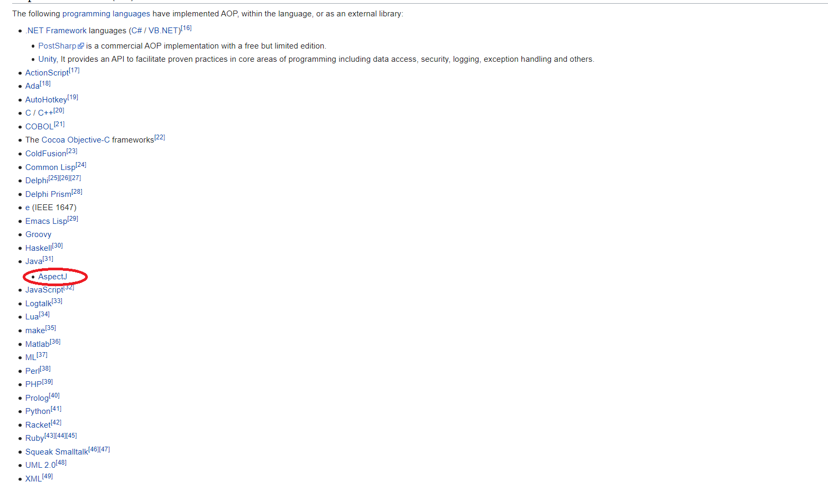
Implementations

Slide 27
AspectJ
A full programming language (i.e., not just an extension)
Compiler javac is replaced by ajc
Compatible with Java
Aspect integration is static (less flexible)
Supported by many IDE (emacs, Eclipse, etc.) + open source and free

Slide 28
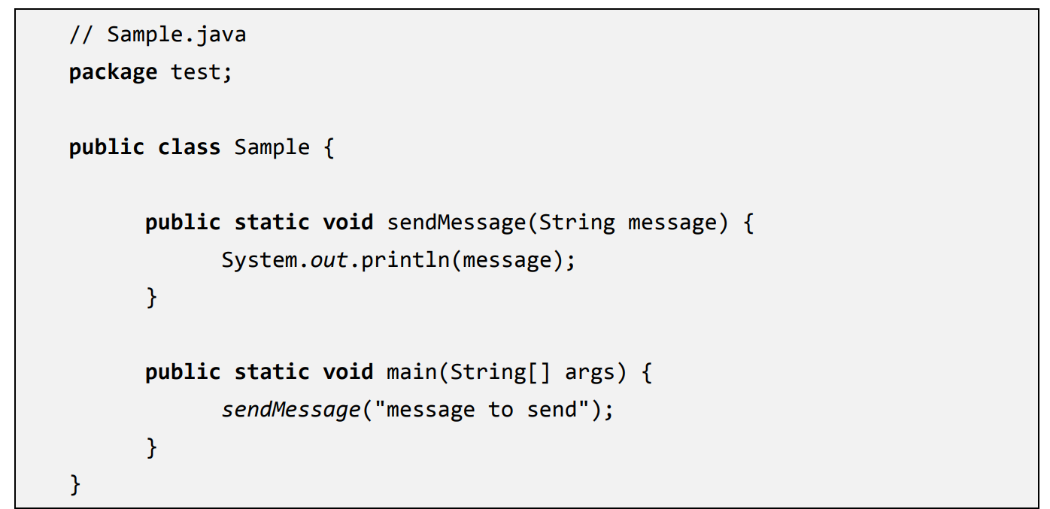
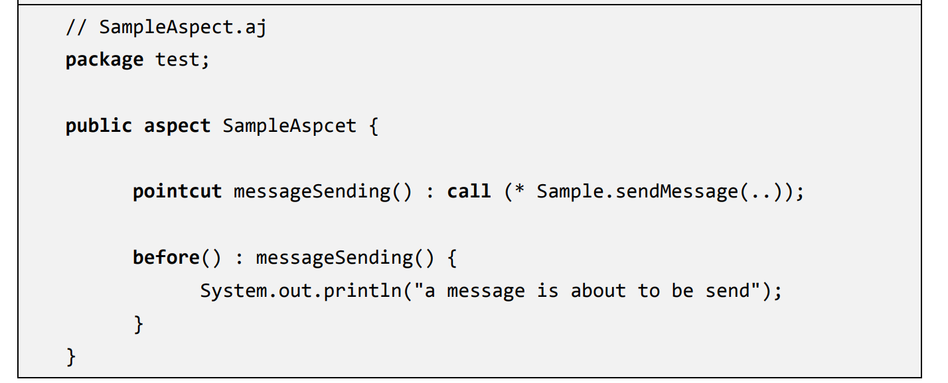
Aspect
~ Class for the non-functional requirements

Slide 29
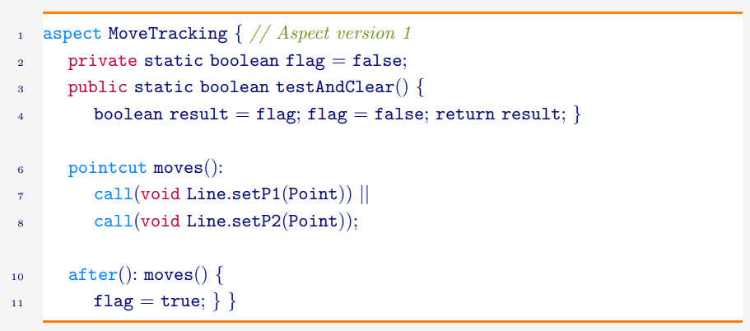
Example: back to the Move Tracker

Slide 30
Aspects cont’d
Definition:
[access specification] aspect <AspectName> [extends class-or-aspect-name]
[implements interface-list]
[<association-specifier>(Pointcut)] {
... aspect body
}
Can contain methods + fields + setters
Can be abstract
Can inherit a class, an abstract aspect, or implement an interface
Cannot be instantiated.

Slide 31
Joint-point
Any identifiable point in a code execution.
Ex: call to a setter of class Line:
Exposed joint-point: can be accessed by an aspect
Every available information (context) can be used.

Slide 32
Categories of Joint-points
Method join points. (the most used). Call/execution
Constructor join points.
Field access join points. Getter/Setter.
Exception handler execution join points.
Class initialization join points. Class loading + static parts
Object initialization join points. E.g., for complementing initialization. Starts from the constructor of the basic Object and ends with the first constructor called.

Slide 33
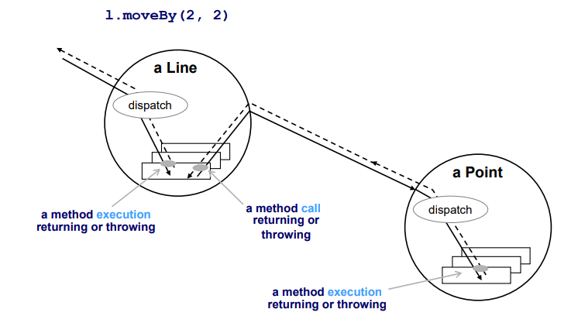
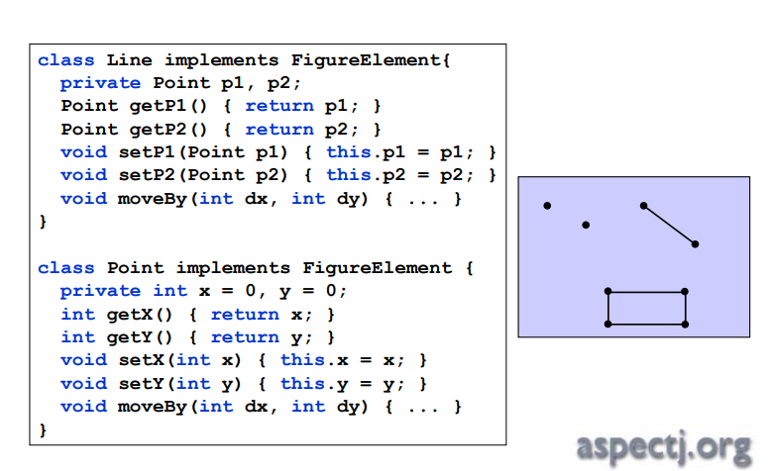
Schematic view

Slide 34
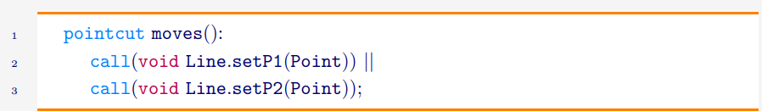
Pointcut
Grouping + naming a range of joint-points
[access specifier] pointcut pointcut-name([args]) : definition
A pointcut can also be anonymous (used on the spot)

Slide 35
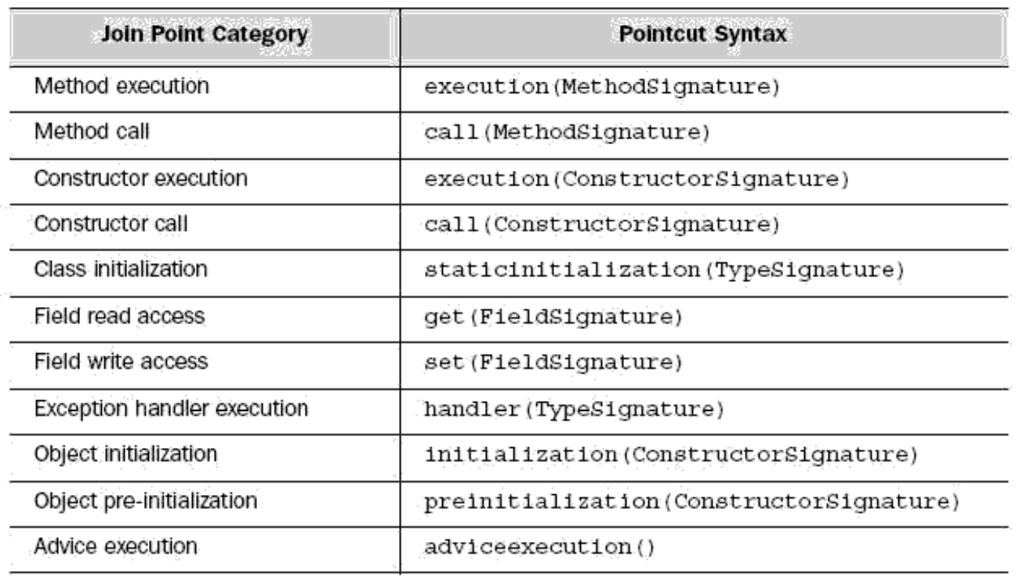
Corresponding signatures in AspectJ

Slide 36
Regular Expressions
* Any character sequence (but . )
.. Any character sequence
+ Any subclass/subinterface of the given data type
!, ||, && Boolean operators

Slide 37
Examples
Account class Account
*Account any type ending by Account
java.*.Date any Date type in a java subpackage (e.g., java.util.Date or java.sql.Date)
public void Account.set*(*) a setter with any input type
public void Account.*() any public method without input and that does not output anything
!public * Account.*() any non-public method
public Account.new() any constructor with no input
* Account.* any field/modifier of access
public !final *.* any non-final field from any class

Slide 38
Advice
~ method
Always refers to a pointcut.
Specifies when to execute (before/after/around)

Slide 39
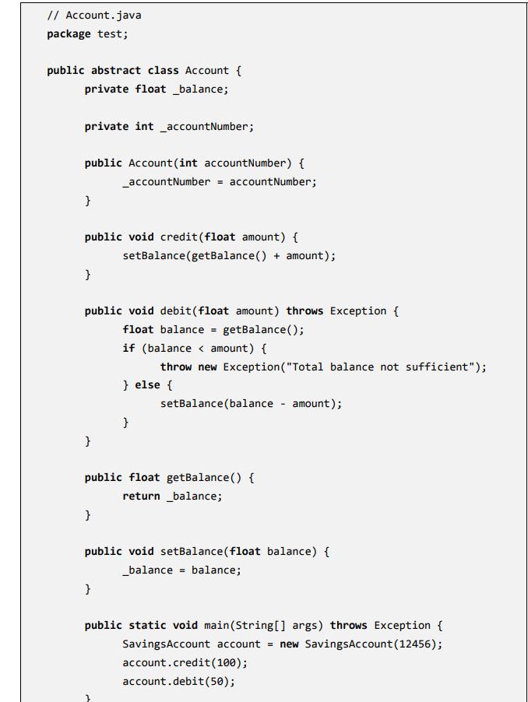
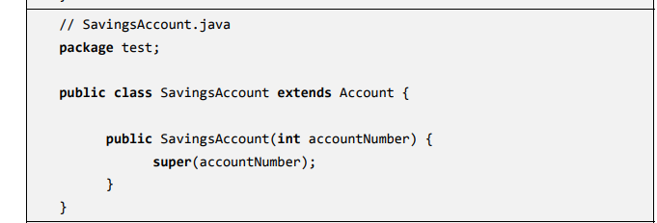
A classic example: Bank Accounts

Slide 40
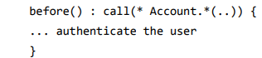
Before
Advice is executed when the method/constructor is called.
Remark: if the advice throws an exception, then the call fails.
Applications:
Logging
Pre-conditions in general

Slide 41
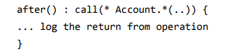
After
Advice is executed after the method/constructor has ended.
Remark: The advice shall be executed regardless of what happened during the call.
Applications:
Data persistence
Post-conditions in general

Slide 42
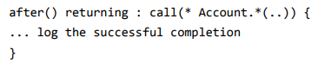
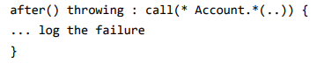
More on After
Only after successful completion:
Only after error:
Remark: input/output of the calls can be given as parameters for the advice

Slide 43
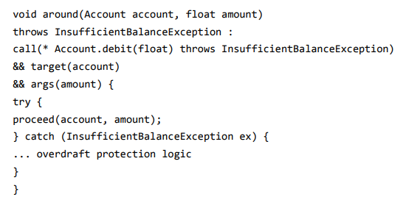
Around
Advice is executed at the beginning of the (call) execution.
Can potentially override everything! ➔ same signature
Original execution can be resumed using proceed
(We can also get the output)

Slide 44
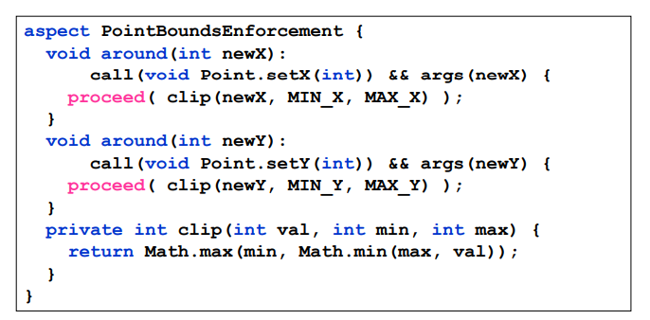
An example

Slide 45
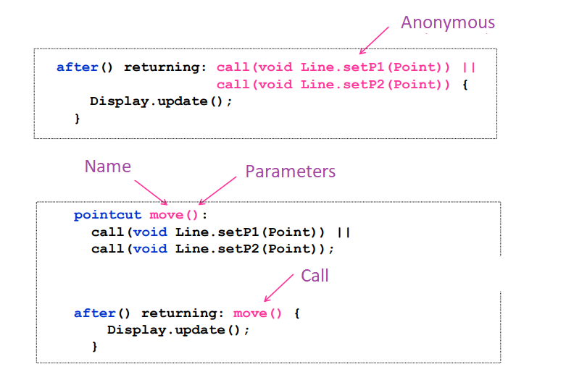
Anonymous vs Named Pointcut

Slide 46
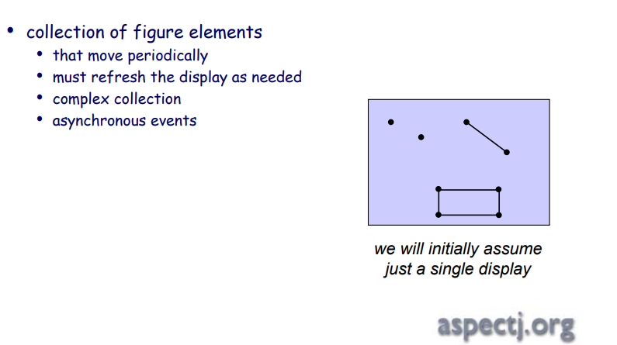
Example: Refresh (1/3)

Slide 47
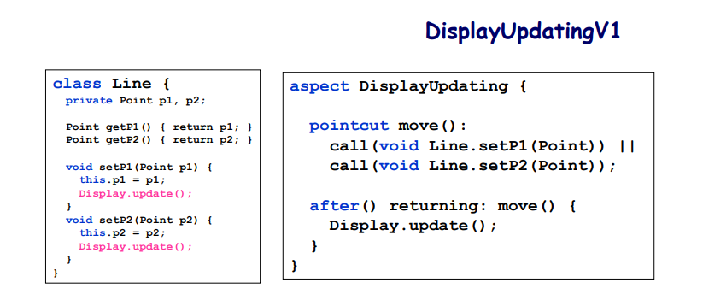
Example: Refresh (2/3)

Slide 48
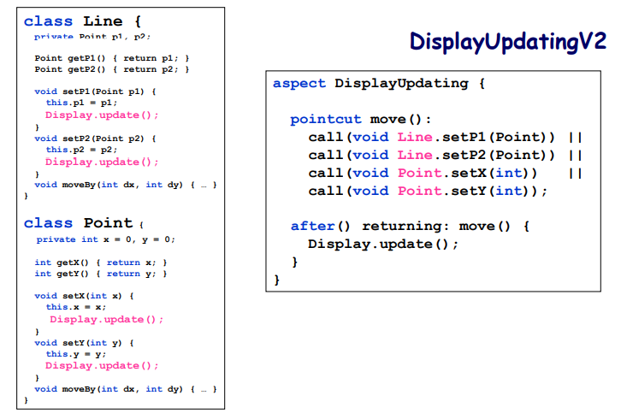
Example: Refresh (3/3)
A pointcut may refer to more than one class

Slide 49
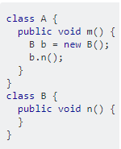
this() vs. target()
this() refers to the current object in which we are
target() refers to the object invoked/referenced
call(*n(..)) when captured from m() has an A-type this and
a B-type target.

Slide 50
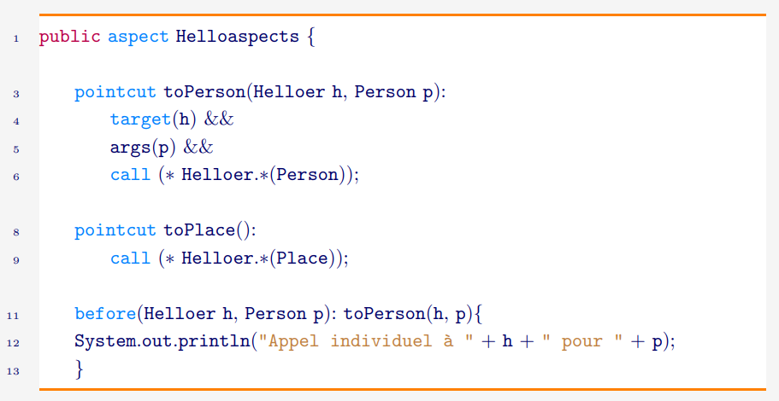
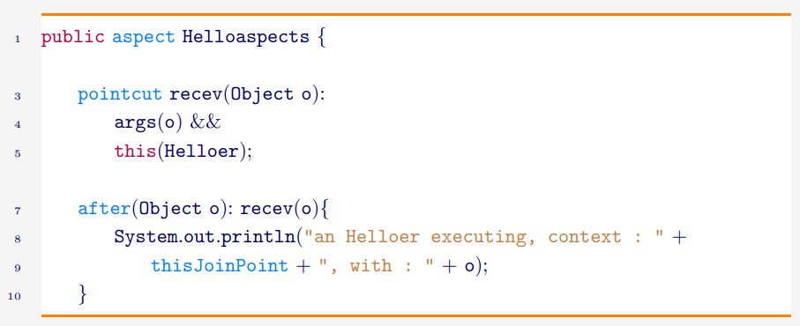
An Example

Slide 51
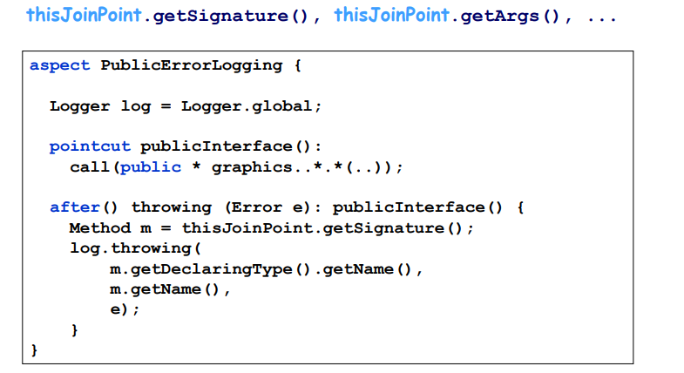
Reflexivity with thisJointPoint

Slide 52
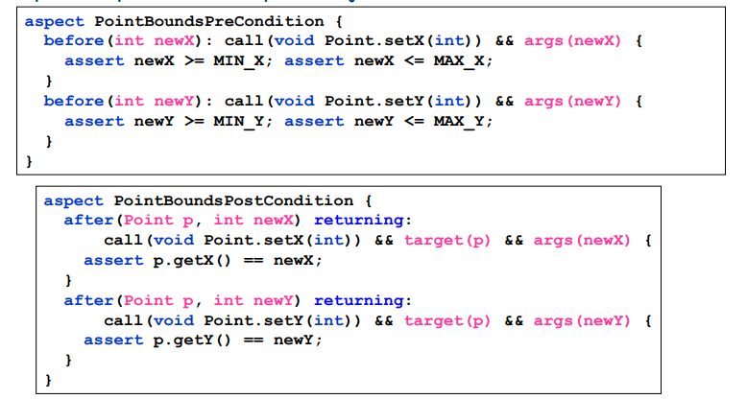
args()
Capture the input arguments
Example:

Slide 53
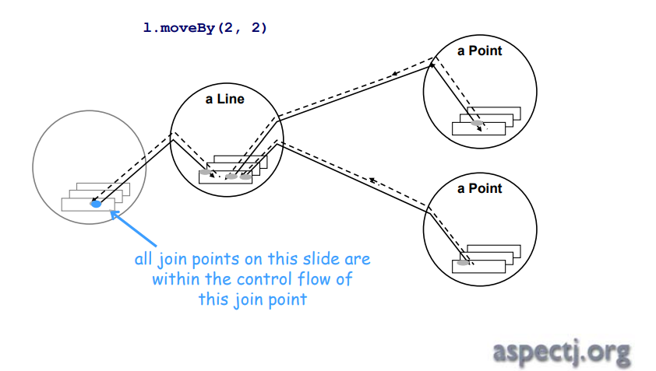
cflow and cflowbelow

Slide 54
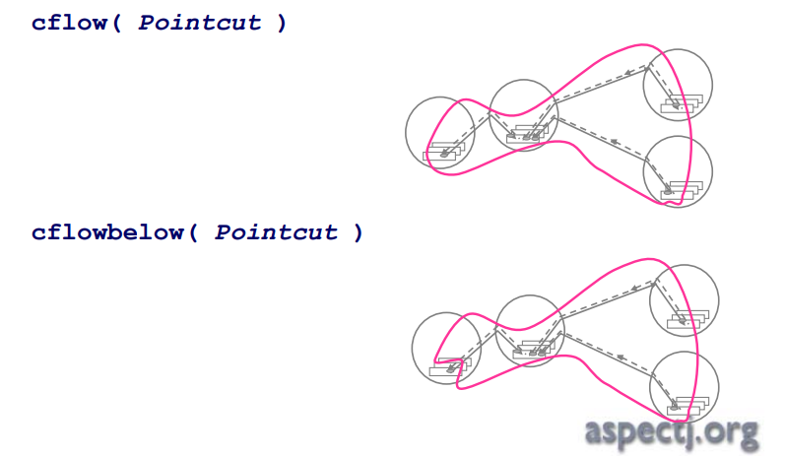
cflow and cflowbelow
Captures all the flow of execution of the joint point (including or not the joint point itself)
Example: call, execution, getter, setter, etc...

Slide 55



cflow and cflowbelow
Captures all the flow of execution of the joint point (including or not the joint point itself)
Example: call, execution, getter, setter, etc...
Risk of StackOverFlow (e.g., with recursive calls)

Slide 56

within and withincode
within(Type) captures all joint-points in the block
withincode(Method) same as above inside a code

Slide 57

Composition of aspects
Question: Two aspects applied to the same joint-point?

Slide 58

Composition of aspects (cont’d)
No pre-defined order, except inside an aspect and its sub-aspects
But we can declare some order over the aspects

Slide 59

(De)Activate an Aspect

Slide 60

Applications: Trace

Slide 61


Applications: Remote Service

Slide 62



Applications: Memoization

Slide 63

Applications: Caching

Slide 64
Limitations of AOP
Sometimes more difficult to read/understand the instruction flow
Logical errors for non-functional requirements may produce cascade effects
``Fragile’’ pointcut definition (sensitivity)
Self-application

Slide 65


